Slide 1

Final Project Presentation – NFL Combine
Sydney Scaccia
DSC 609

Slide 2

Can the combine results accurately predict potential professional athlete’s positions correctly?

Slide 3
Literature Review
“The NFL Combine: Does It Predict Performance in the National Football League?”
Frank Kuzmits & Arthur Adams
How Much Does the Combine Reveal About Future NFL Players?”
Marcus Woo
“Does the NFL Combine Have Any Predictive Value to NFL Success?”
Tyler Schlater

Slide 4

Variables
Dependent Variable
Player’s Position
Independent Variables
Height
Weight
Forty Yard Dash Time
The Number of Repetitions on the Bench Press
Broad Jump Distance
Three-Cone Drill time
Shuttle Run Time

Slide 5

Preprocessing the Data
Remove and “NA” values
Scale the Data

Slide 6
* RBF SVM =Radial Based Function Support Vector Machine
* SGD = Stochastic Gradient Descent, RELU = Rectified Linear Activation, PCA = Principal Component Analysis

Slide 7
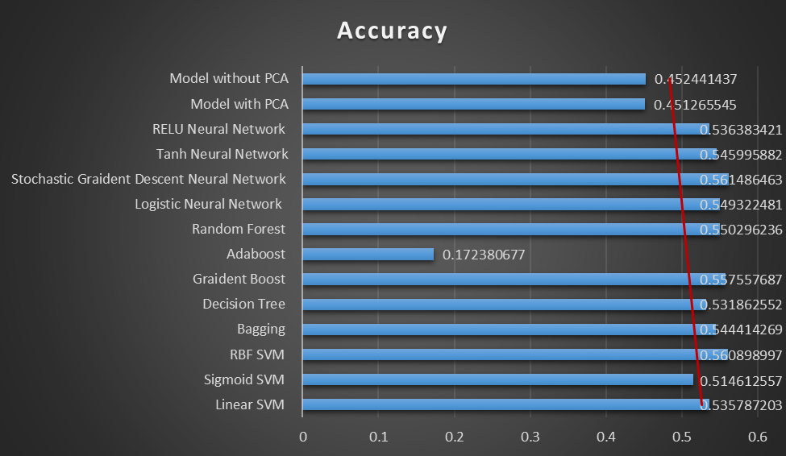

Slide 8
Future Analysis & Potential Issues

Slide 9
References
Kuzmits, F. E., & Adams, A. J. (2008). The NFL Combine: Does It Predict Performance in the National Football League? Journal of Strength and Conditioning Research, 22(6), 1721–1727. https://doi.org/10.1519/jsc.0b013e318185f09d
Schalter, T. (2017, October 3). Does the NFL Combine Have Any Predictive Value to NFL Success? Bleacher Report. https://bleacherreport.com/articles/1535606-does-the-nfl-combine-have-any-predictive-value- to-nfl-.
Woo, M. (2019, March). How Much Does the Combine Reveal About Future NFL Players? Inside Science. https://www.insidescience.org/news/how-much-does-combine-reveal-about-future-nfl-players.

